Slide 1
BT201
Biochemical Process Calculations
09/11/2022

Slide 2
Introduction of non reactive process
Pressure, T, composition, phase can be changed during process
Objective
Enthalpy and internal energy can be calculated for:
Changes in P at constant T and state of aggregation
Changes in T at constant P and state of aggregation
Phase changes at constant T and P-—melting, solidifying, vaporizing, condensing, sublimating
Mixing of two liquids or dissolving of a gas or a solid in a liquid at constant T and P

Slide 3
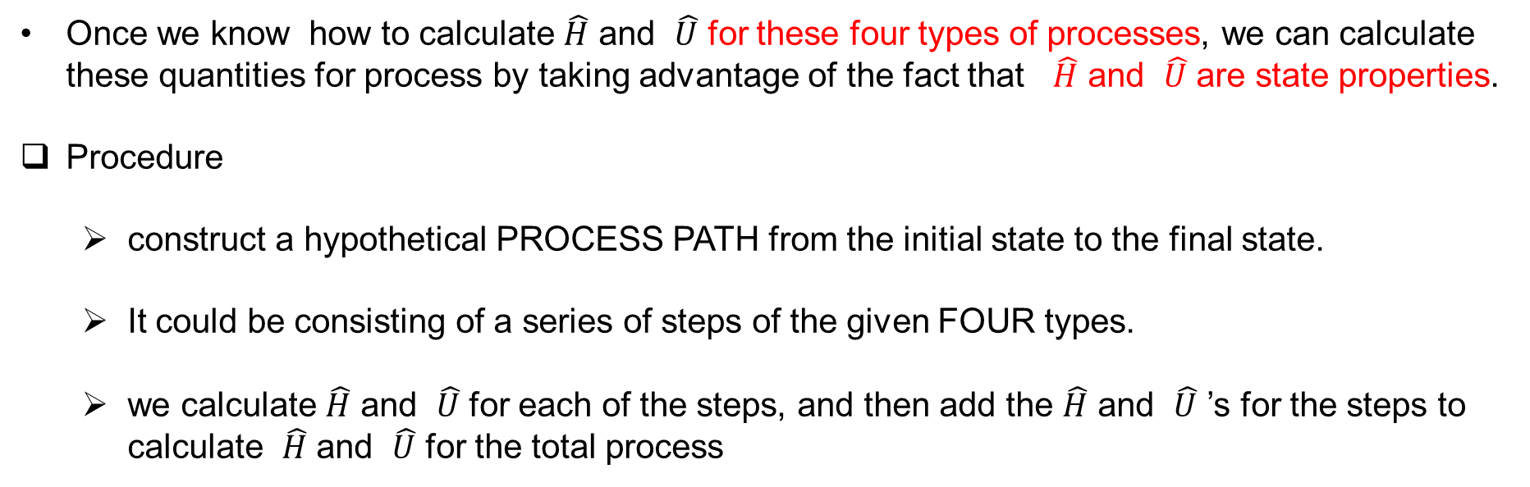
Calculating specific internal energy and specific enthalpy
Once we know how to calculate $\hat{H}$ and $\hat{U}$ for these four types of processes, we can calculate these quantities for process by taking advantage of the fact that $\hat{H}$ and $\hat{U}$ are state properties.
Procedure
construct a hypothetical PROCESS PATH from the initial state to the final state.
It could be consisting of a series of steps of the given FOUR types.
we calculate $\hat{H}$ and $\hat{U}$ for each of the steps, and then add the $\hat{H}$ and $\hat{U}$ ’s for the steps to calculate $\hat{H}$ and $\hat{U}$ for the total process

Slide 4
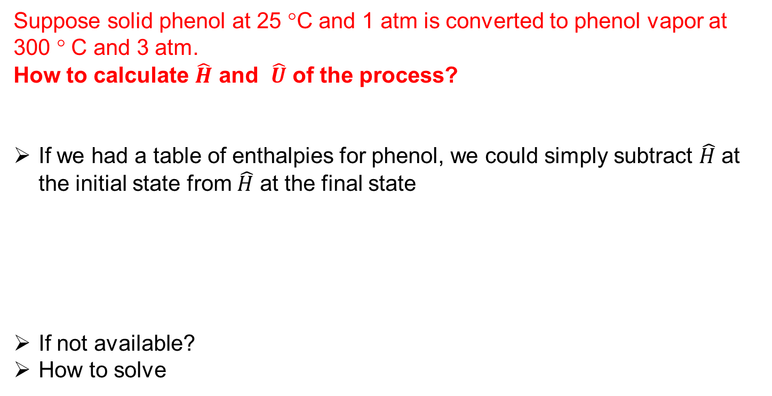
Suppose solid phenol at 25 °C and 1 atm is converted to phenol vapor at 300 ° C and 3 atm.
How to calculate $\hat{H}$ and $\hat{U}$ of the process?
If we had a table of enthalpies for phenol, we could simply subtract $\hat{H}$ at the initial state from $\hat{H}$ at the final state
If not available?
How to solve

Slide 5
Do not have such a table.
Our task is then to construct a hypothetical process path from the solid at 25 °C and 1 atm to the vapor at 300 °C and 3 atm.
How to construct hypothetical path
What are the constrained to be followed?
In the process, T, P, phase are changing
Each step in the hypothetical path should have only one of these three factor changing
Phase change should happen at temperature where enthalpy associated with phase change available in handbook

Slide 6
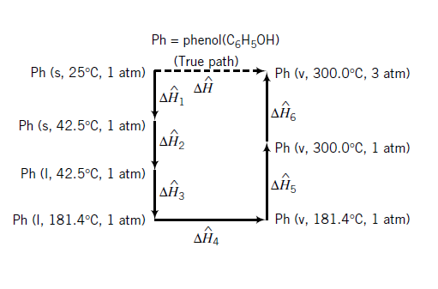
Procedure:
What are the melting and boiling point of the compound?
Note that enthalpy changes for the melting of phenol at 1 atm and 42.5 °C (the normal melting point of phenol) available
For the vaporization of phenol at 1 atm and 181.4 ° C (the normal boiling point of phenol) available.
We therefore choose this hypothetical process path

Slide 7

Notice that in this path, the first, third, and fifth steps are Type 2 (change in T at constant P ),
the second and fourth steps are Type 3 (change in phase at constant T and P ),
sixth step is Type 1 (change in P at constant T )
Also notice that the phase changes were made to occur at the conditions for which tabulated enthalpy changes are available.

Slide 8
Energy balance procedure
Perform all required material balance calculations
Write the appropriate form of the energy balance (closed or open system) and delete any of the terms that are either zero or negligible for the given process system.
Choose a reference state—phase, temperature, and pressure—for each species involved in the process.
For a closed constant- volume system, construct a table with columns for initial and final amounts of each species and specific internal energies relative to the chosen reference states. For an open system, construct a table with columns for inlet and outlet stream component flow rates and specific enthalpies relative to the chosen reference states.

Slide 9

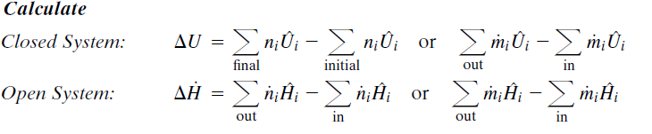
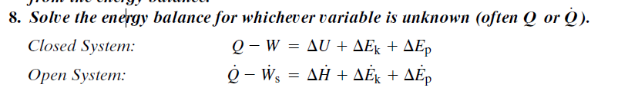
5. Calculate all required values of and insert the values in the appropriate
places in the table.
6.
7. Calculate any work, kinetic energy, or potential energy terms that you have not dropped
from the energy balance.

Slide 10
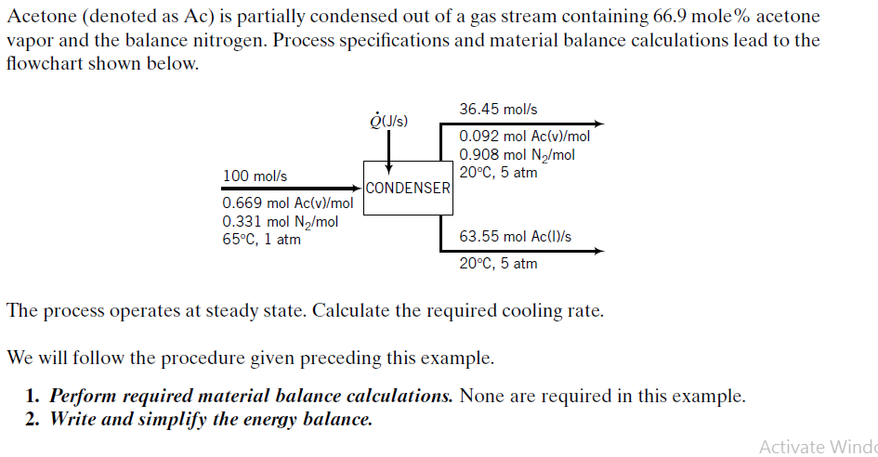
Energy Balance on a Condenser

Slide 11
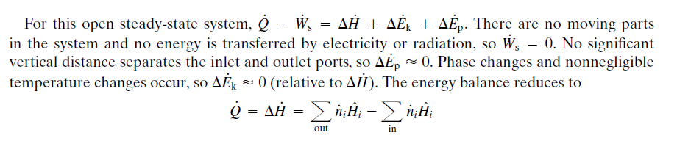
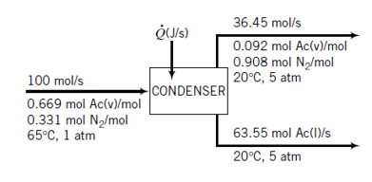
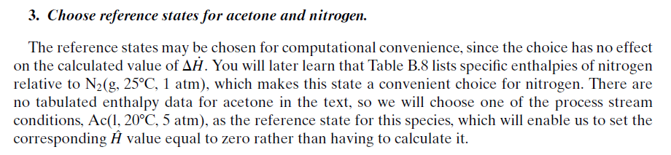

Slide 12
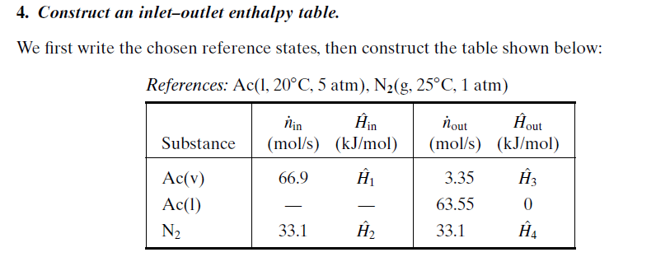
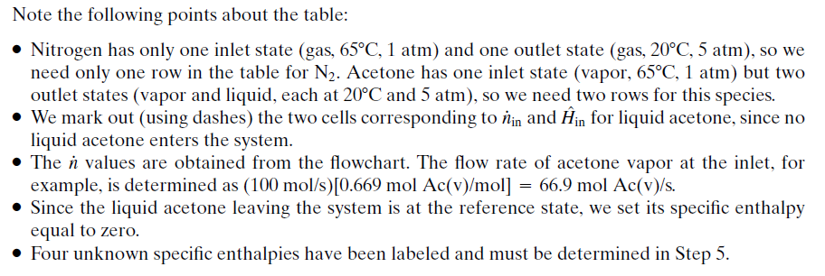

Slide 13
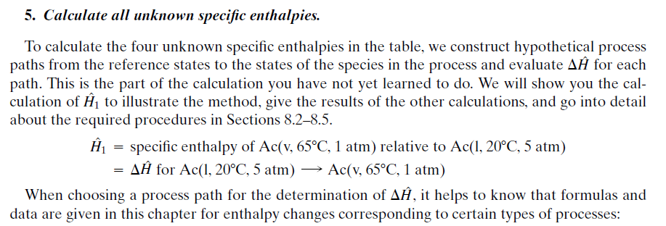

Slide 14

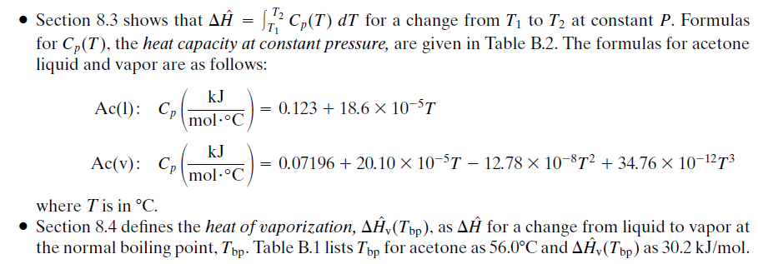
At constant T,
Later, we will learn

Slide 15
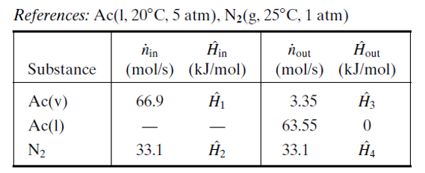
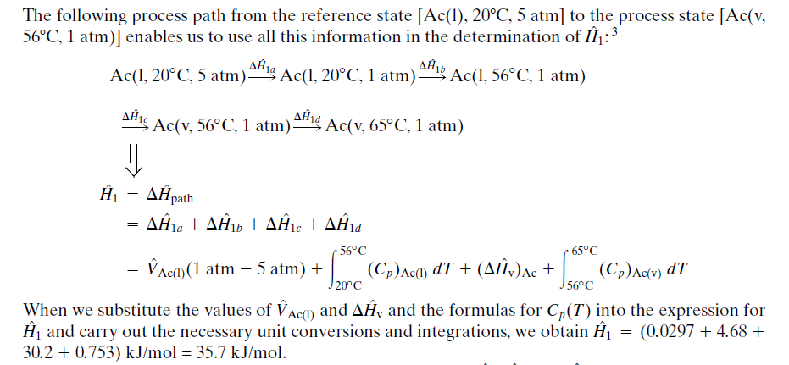

Slide 16
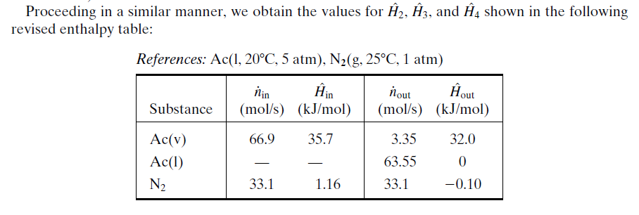
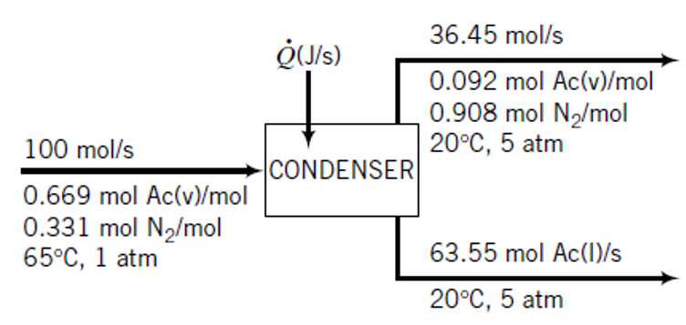

Slide 17
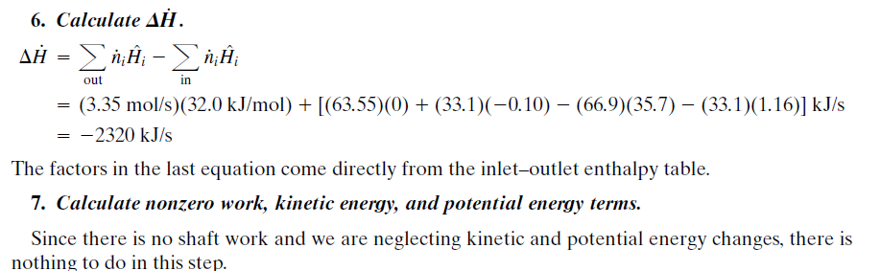
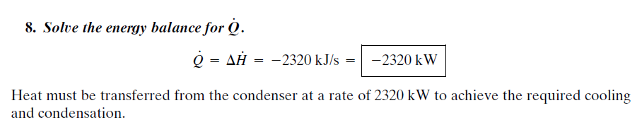

Slide 18
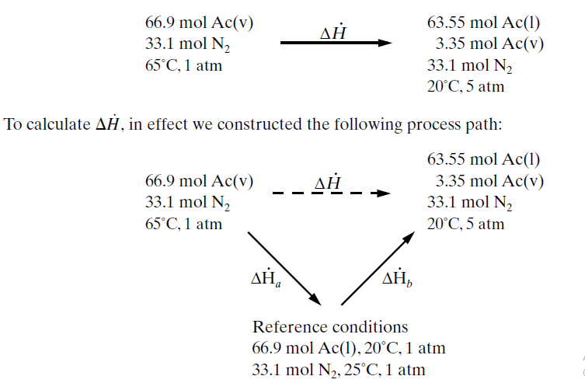
process

